Slide 1

D”P gva¨wgK Z_¨ I †hvMv‡hvM cÖhyw³

Slide 2


Slide 3
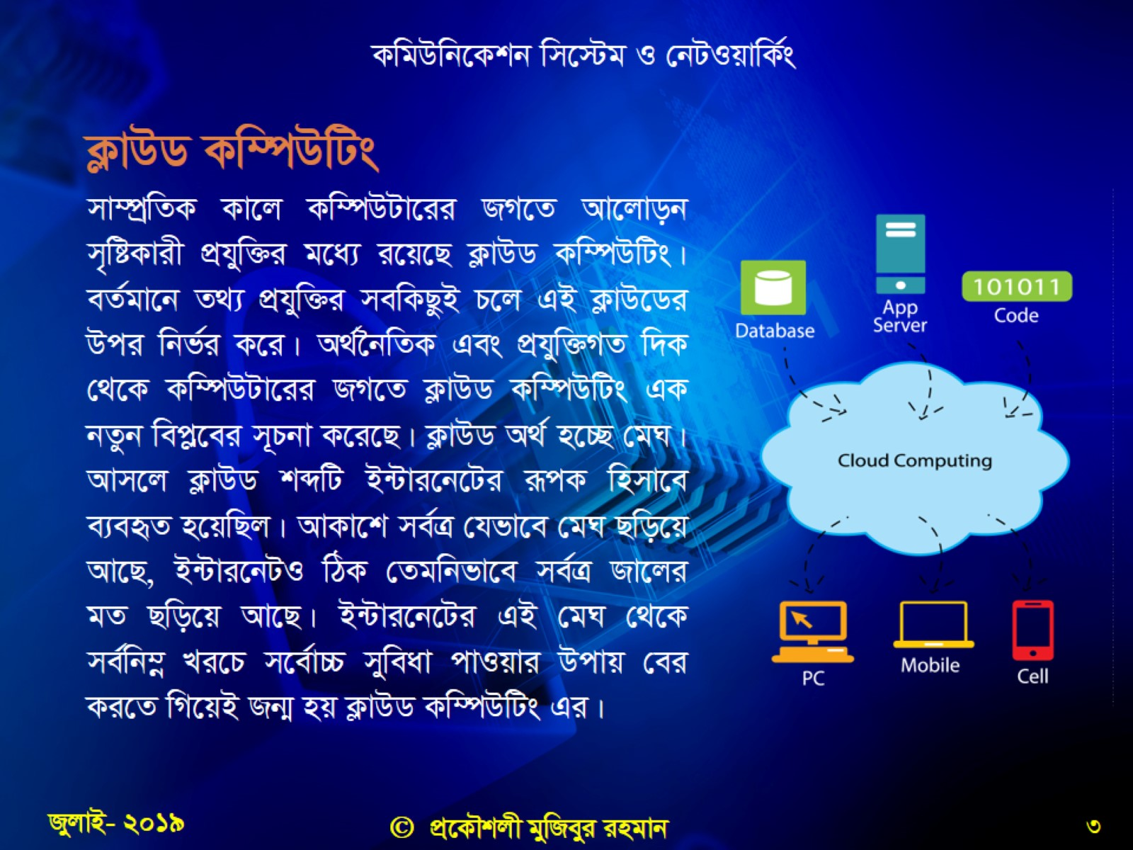

Slide 4
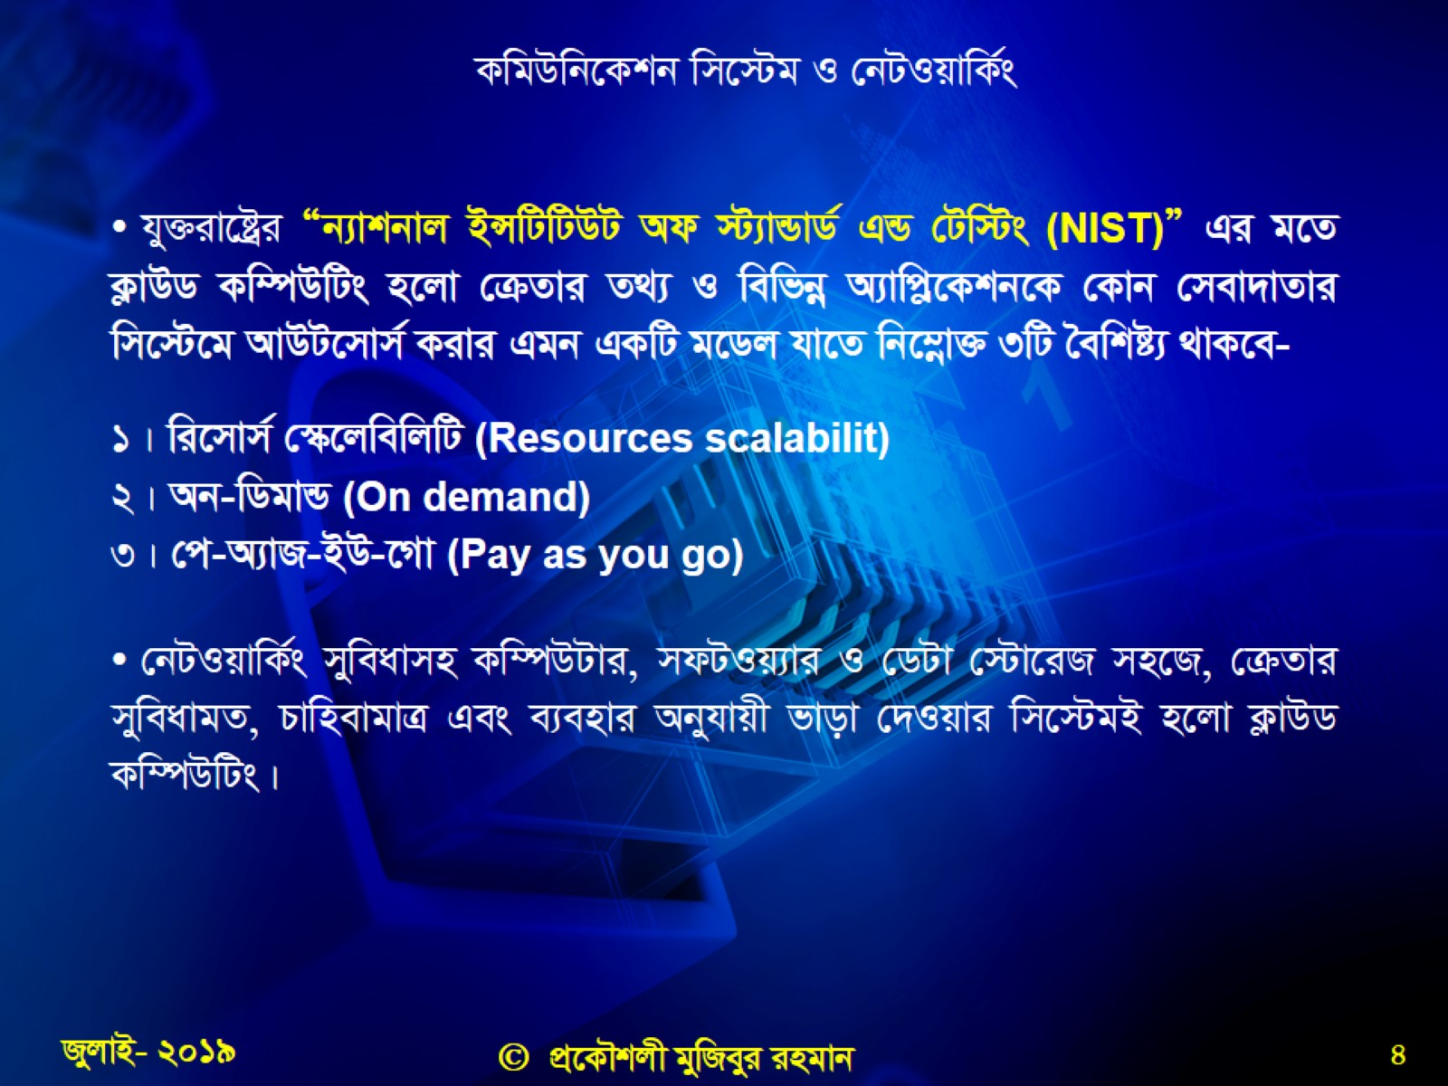

Slide 5
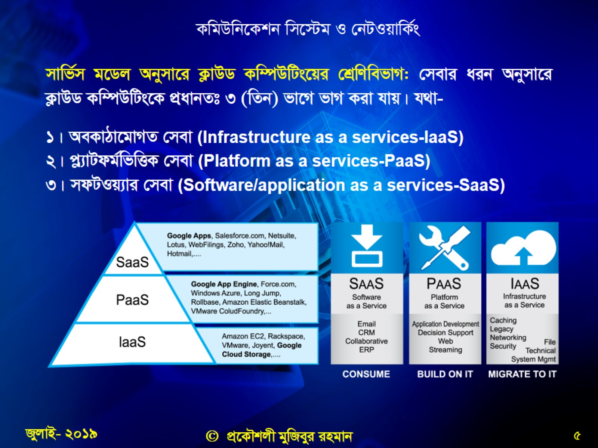

Slide 6
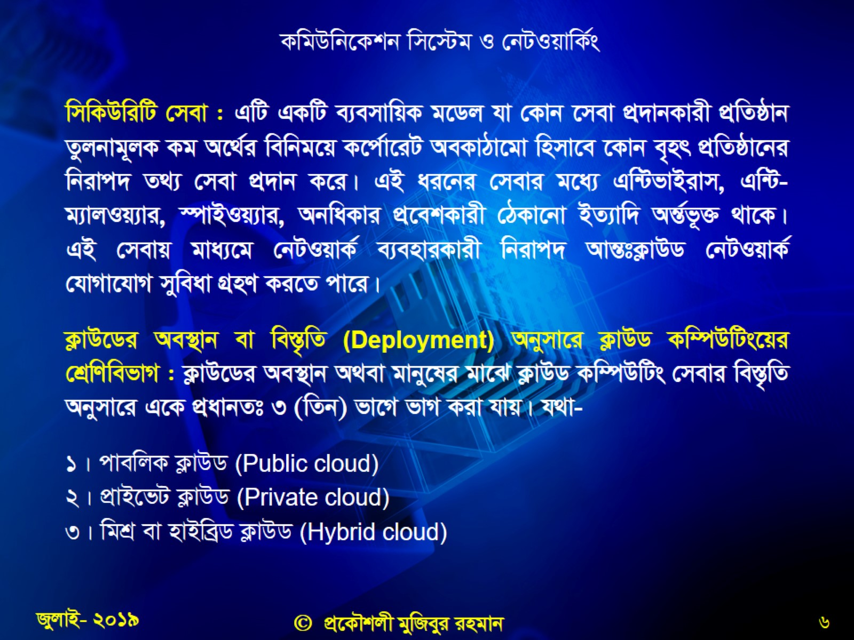

Slide 7
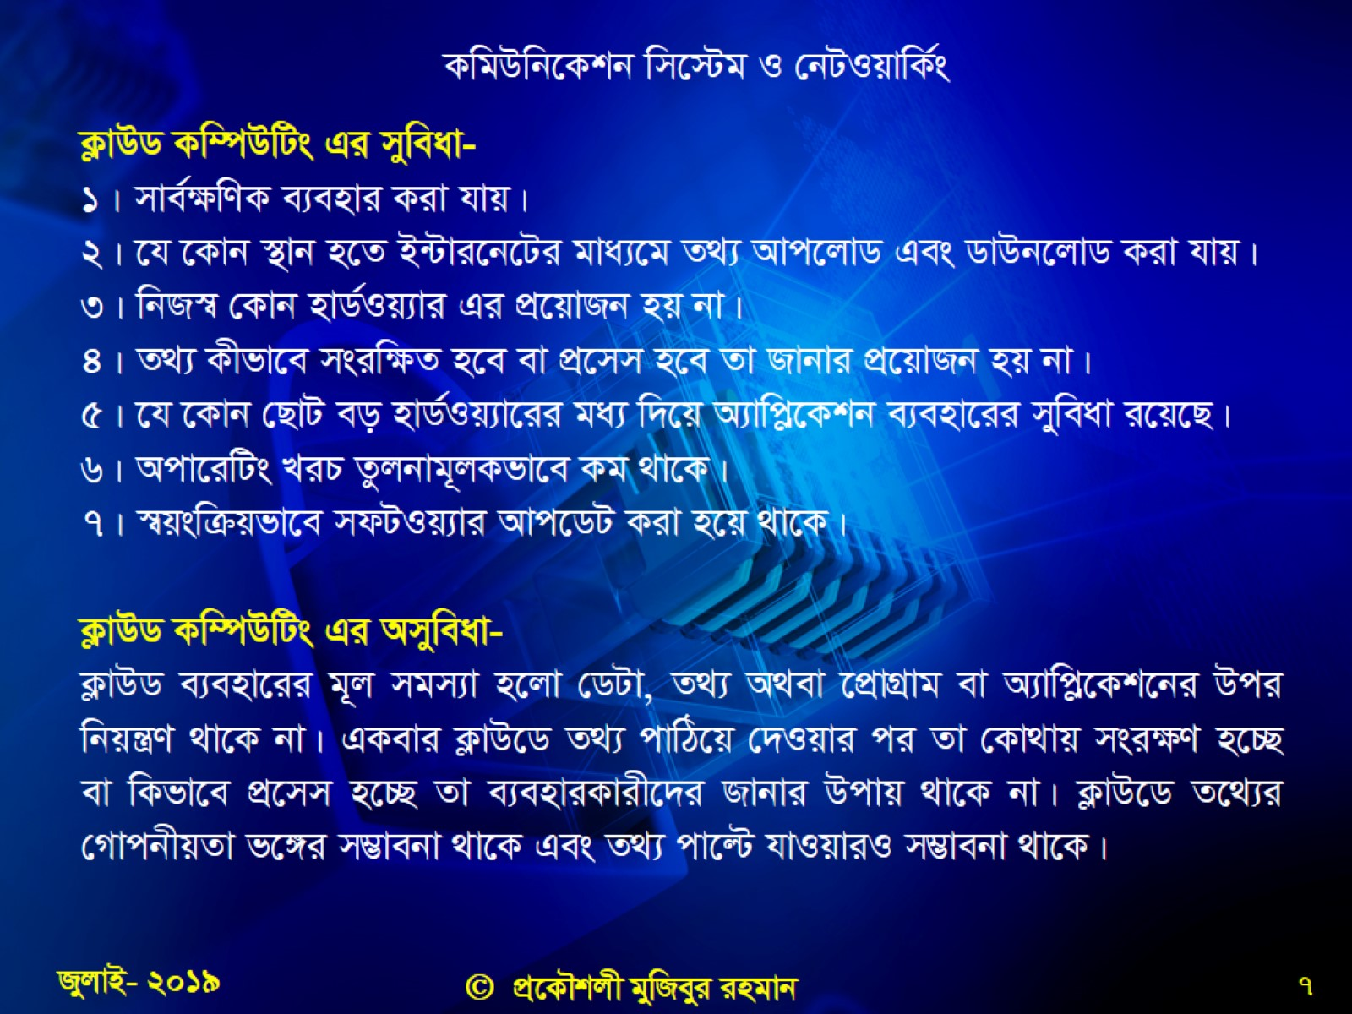

Slide 8

cÖ‡kœvËi ce©

